Slide 1

Bachelor of Technology
Computer Engineering Sem : 7
01CE0717 – DevOps Essentials
Unit : 1 - Introduction to DevOps

Slide 2

Content
DevOps Essentials
Introduction to AWS
Introduction to GCP
Introduction to Azure
Git
Concept of GitHub

Slide 3
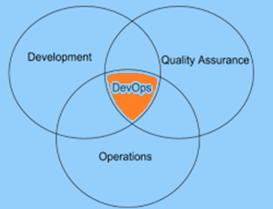
DevOps Essentials
What is DevOps?
DevOps is a set of practices that combines software development (Dev) and IT operations (Ops) to promote the development life cycle and deliver high-quality software continuously.

Slide 4
DevOps Essentials
Why DevOps?
DevOps enhances the organization’s performance, improves the productivity and efficiency of development and operations teams.
Bringing the two teams together centralizes the responsibility on the entire team and not specific individuals working.
DevOps is more than just a tool or a process change. It inherently requires an organizational culture shift.

Slide 5
DevOps Essentials
Why DevOps?
DevOps is driven by various factors.
Demand for an increased rate of production releases – from application and business unit stakeholders
Increased usage of data center automation and configuration management tools.
Use of agile and other development processes and methods
Increased focus on test automation and continuous integration methods
Wide availability of virtualized and cloud infrastructure.

Slide 6
DevOps Essentials
Benefits
Technical Benefits
Continuous software delivery is possible.
There is less complexity to manage the project.
The problems in the project get resolved faster.
Cultural Benefits
The productivity of teams increased.
There is higher employee engagement.
There arise greater professional development opportunities.

Slide 7
DevOps Essentials
Benefits
Business Benefits
The faster delivery of the product is possible.
The operating environment becomes stable.
More time is available for innovation rather than fixing and maintaining.

Slide 8
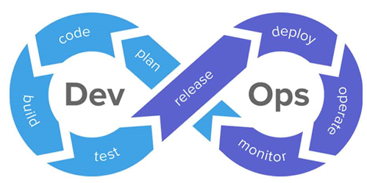
DevOps Essentials
DevOps Architecture

Slide 9
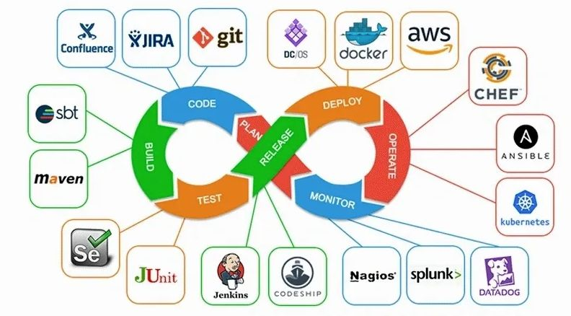
DevOps Essentials

Slide 10
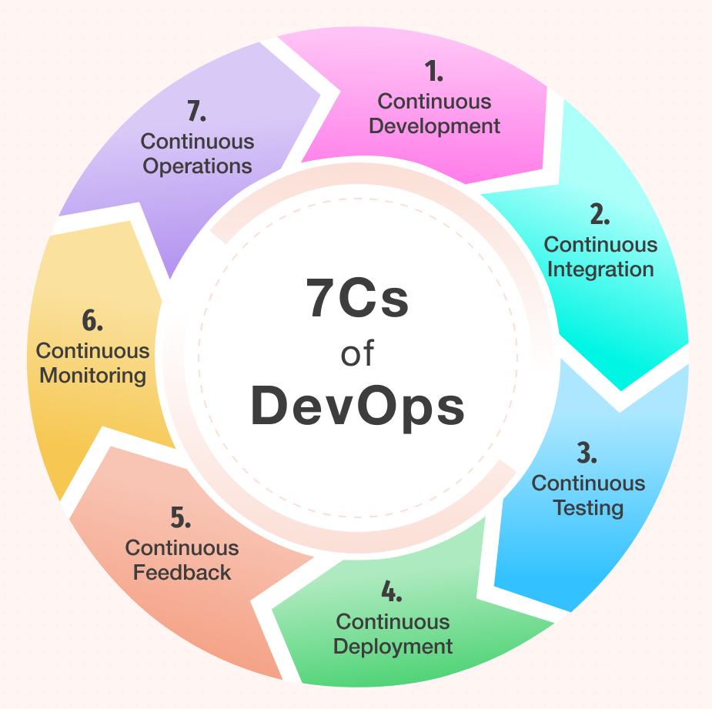
DevOps Essentials
DevOps Lifecycle

Slide 11
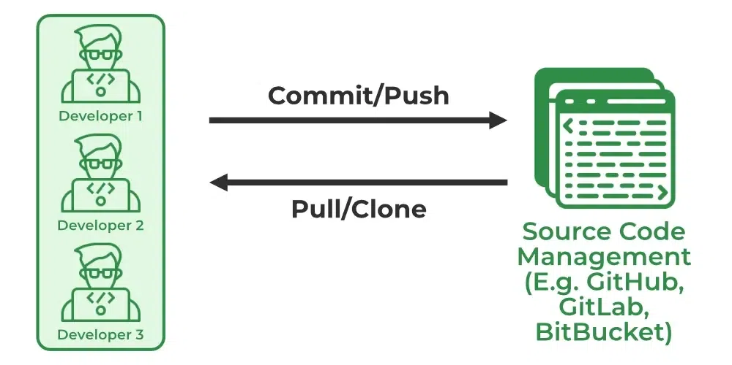
DevOps Essentials
DevOps Lifecycle
1. Continuous Development
In this phase, the planning and coding of software is done.
There are no specific tools for planning, but the development team requires some tools for code maintenance like GIT and Jira.

Slide 12
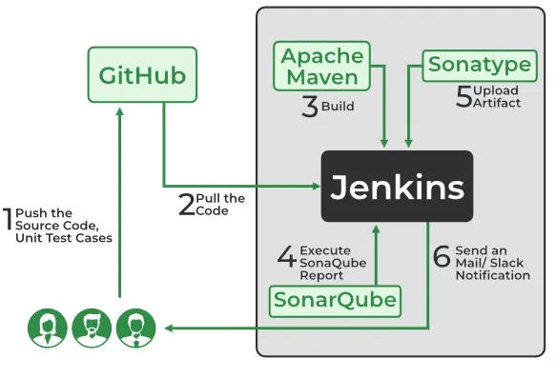
DevOps Essentials
DevOps Lifecycle
2. Continuous Integration
Most Crucial phase
(heart of entire DevOps Lifecycle)
To commit changes in the source code frequently; new functionality integrated with the existing code;
4 Stages:
Getting Source Code from SCM
Building the code
Code quality review
Storing the build artifacts
Tools like Jenkins, GitLab CI, CircleCI, etc.

Slide 13
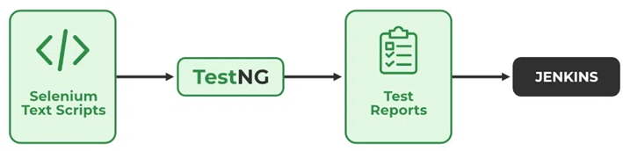
DevOps Essentials
DevOps Lifecycle
3. Continuous Testing
In this phase, the software is continuously tested for bugs.
Automated testing tools like Selenuim, TestNG, JUnit, etc.

Slide 14
DevOps Essentials
DevOps Lifecycle
4. Continuous Deployment
In this phase, the final code is deployed on production servers.
The continuous deployment includes configuration management to make the deployment of code on servers accurate and smooth. Development teams release the code to servers and schedule the updates for servers, keeping the configurations consistent throughout the production process.
Tools like Chef, Puppet, Ansible, and SaltStack.

Slide 15
DevOps Essentials
DevOps Lifecycle
5. Continuous Feedback
Continuous feedback came into existence to analyze and improve the application code. During this phase, customer behavior is evaluated regularly on each release to improve future releases and deployments.
6. Continuous Monitoring
Monitoring is a phase that involves all the operational factors of the entire DevOps process, where important information about the use of the software is recorded and carefully processed to find out trends and identify problem areas.
By continuous monitoring, we can get notified before anything goes wrong. We can gather many performance measures, including CPU and memory utilization, network traffic, application response time, error rates, etc. Tools - Nagios

Slide 16
DevOps Essentials
DevOps Lifecycle
7. Continuous Operations
Continuous operation automates the process of launching the app and its updates. It uses container management systems like Kubernetes and Docker to eliminate downtime.
Through continuous operations, developers save time that can be used to accelerate the application’s time-to-market.

Slide 17
Content
DevOps Essentials
Introduction to AWS
Introduction to GCP
Introduction to Azure
Git
Concept of GitHub

Slide 18
Introduction to AWS
Cloud computing is the delivery of computing services over the internet rather than using local servers or personal devices. We can access data from a remote server.
Amazon Web Services (AWS) is a comprehensive and widely adopted cloud platform provided by Amazon.
It includes services for storage, databases, analytics, networking, mobile development tool, management tool, IoT, Security, and enterprise applications.
It provides different services of cloud such as Infrastructure as a Service (Iaas), Platform as as Service (Paas) and packaged Software as a Service (SaaS).

Slide 19
Introduction to AWS
Features of AWS
Flexibility
Cost Effective
Scalable and elastic
Secure
High Performance

Slide 20
Introduction to AWS
Services offered by AWS
Amazon Elastic Cloud Computer (EC2)
EC2 is a machine with an operating system and hardware components of developer’s choice. But the difference is that it is totally virtualized. The developer can run multiple virtual computers in a single physical hardware.
It provides scalable computing capacity in AWS cloud
It is secure.

Slide 21
Introduction to AWS
Services offered by AWS
Amazon Simple Storage Service (S3)
It is a scalable, high-speed, web-based cloud storage service
Data can be transferred to S3 via API
It is object-based storage (store images, word files, pdf files, etc)
File size can be from 0 to 5TB

Slide 22
Introduction to AWS
Services offered by AWS
Amazon Virtual Private Cloud (VPC)
Logically isolated area of the AWS cloud which can be used as a private network but it is virtual. It resembles your traditional networking.
You have control over virtual networking environment including a selection of your IP address range, the creation of subnets and configuration of route tables, gateways, etc.
It provides multiple layers of security to the VPC

Slide 23
Introduction to AWS
Services offered by AWS
Amazon Relational Database Service (RDS)
It is relational database cloud service which store the data on cloud
Similar to RDMS like data migration, backup, recovery, and patching
It supports PostgreSQL, MYSQL, Maria DB, Oracle, SQL Server and Amazon Aurora

Slide 24
Introduction to AWS
Services offered by AWS
Amazon CloudFront
It is a fast Content Delivery Network (CDN) service
It is a globally-distributed network which securely transfers content such as software, SDKs, videos, etc. to the clients, with high transfer speed.
High security with the ‘content privacy’ feature.
Gives lowest latency for transfer the content

Slide 25
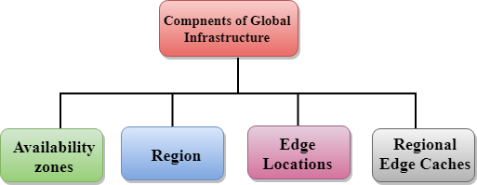
Introduction to AWS
Global Infrastructure of AWS

Slide 26
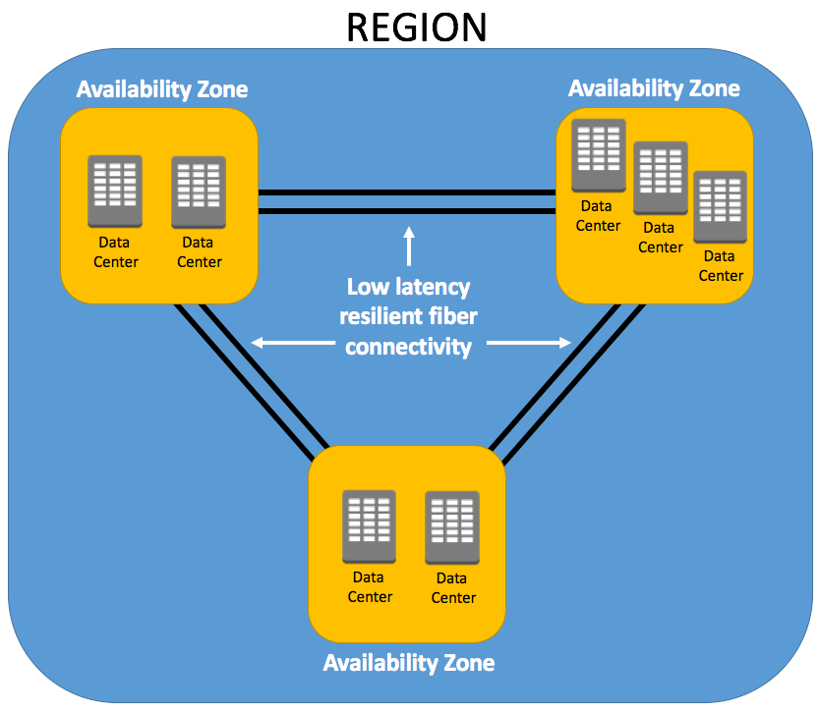
Introduction to AWS
Global Infrastructure of AWS
Region
It is physical location or geographical area.
Collection of data centers which are completely isolated from other regions.
A region consists of more than two availability zones connected to each other though links.

Slide 27
Introduction to AWS
Global Infrastructure of AWS
Availability Zones
It is grouping of one or more discrete data centers which provides applications and services in an AWS region.
Availability zones are connected though low latency and high throughput networking channels.
If one zone fails, the other zone will operate fine without any effect.

Slide 28
Introduction to AWS
Global Infrastructure of AWS
Edge locations
It is used for caching the content.
Distribute the content to end users with reduced latency.
Regional edge cache
Larger cache than an individual edge location
When user requests the data, then data is no longer available at the edge location. Therefore, the edge location retrieves the cached data from the Regional edge cache instead of the origin servers that have high latency.

Slide 29
Content
DevOps Essentials
Introduction to AWS
Introduction to GCP
Introduction to Azure
Git
Concept of GitHub

Slide 30
Introduction to GCP
GCP stands for Google Cloud Platform
GCP offered by Google, is a suite of cloud computing services that runs on the same infrastructure that Google uses internally for its end-user products, such as Google Search, Gmail, Google Drive and YouTube.
It provides IaaS, PaaS and Serverless computing environments.
It allows to store, manage and analyze data.
It is used for developing, deploying and scaling applications on Google’s environment.
The services of GCP can be accessed by software developers, cloud administrators and IT Professionals over the Internet or through a dedicated network connection.

Slide 31
Introduction to GCP
Features of GCP
Tools and services
Speed
Cost effective
Security

Slide 32
Introduction to GCP
Services using GCP
Compute
Computer engine allows us to create Virtual Machines (VM), allocate CPU and Memory and choose from SSD or HDD storage. It allows you to create a workstation or computer virtually and handle all its details.
Networking
Virtual Private Cloud (VPC) : provides the flexibility to scale and control how workloads connect regionally and globally. You can manage your IP address to google network across all the regions.

Slide 33
Introduction to GCP
Services using GCP
Networking
Virtual Private Cloud (VPC)
Cloud DNS : It is scalable, reliable and managed authoritative DNS service. It is also programmable.
Premium Tier Network: It is for high performance routing. Users can use the global fiber network, with the globally distributed Points of Presence (POP).
Cloud Load Balancing: distributes workload across different computing resources to balance the entire system performance.

Slide 34
Introduction to GCP
Services using GCP
Storage
Google Cloud Storage
Cloud SQL
Cloud BigTable
Big Data
BigQuery
Google Cloud Dataproc
Cloud Dataflow
Cloud AI
AutoML

Slide 35
Content
DevOps Essentials
Introduction to AWS
Introduction to GCP
Introduction to Azure
Git
Concept of GitHub

Slide 36
Introduction to Azure
Microsoft Azure, formerly known as Windows Azure, is Microsoft’s public cloud computing platform.
It provides range of capabilities, including SaaS, PaaS, and IaaS.
It provides a broad range of cloud services, including compute, analytics, storage and networking.

Slide 37
Introduction to Azure
Features of Azure
Unique storage system
Flexibility
Scaling
Security
Cost effective
Strong support in analytics

Slide 38
Introduction to Azure
Services using Azure
Compute Domain
App Service
Virtual Machine
Functions
Storage
Blob Storage
Queue Storage
File Storage
Database
Cosmos DB
MySQL
MSSQL
Networking
Auto Scaling
Load Balancing

Slide 39
Content
DevOps Essentials
Introduction to AWS
Introduction to GCP
Introduction to Azure
Git
Concept of GitHub

Slide 40
Git and Conecpt of GitHub
Git
Git is a DevOps tool used for source code management.
It is free and open-source version control system used to handle small to very large projects efficiently.
It is used to track changes in the source code, enabling multiple developers to work together.

Slide 41
Git and Conecpt of GitHub
Git Features
Free and open–source tool
Keeps track of any addition, modification, deletion
It creates backups
Creating branches and manage it
Scalable
Secure

Slide 42
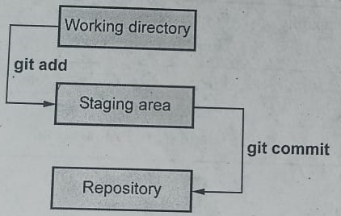
Git and Conecpt of GitHub
Git Workflow
Untracked file
Tracked file
Working directory
Staging area
Repository
Git Commands
Refer Practical-1

Slide 43
Git and Conecpt of GitHub
Git | GitHub
It it a command line tool | It is a GUI
It is a software | It is a service
It is installed locally on the PC | It is hosted on the web
Maintained by Linux | Maintained by Microsoft
Git is a version control system to manage source code history | GitHub is a hosting service for Git repositories
It has minimum external tool configuration | It has as active marketplace for tool integration

Slide 44


